Slide 1
Music Video Pitch
By Charlotte Lloyd, James Beesley, Jordan Scott and Tara Pilkington

Slide 2
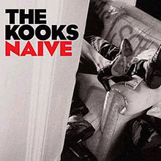
Our Chosen Song
The song we have chosen to create our music video for is ‘Naïve’ by British indie rock band The Kooks. The song was released on the 27th March 2006 as the forth single of the ‘Inside In The Inside Out’ album. The song charted at fifth place in the singles UK chart, and therefore the best-selling single of their careers. The song also made it as the 19th best-selling single of 2006.
2 years later The Kooks finally released the music video to accompany the track. To this date it has had 20,375,172 views.
We have decided to pick this song, due to it being so well known and iconic.
We have decided to pick this song, due to it being so well known and iconic.
The track has been covered by Lily Allen, which was further used in the well-known film Angus, Thongs and Perfect Snogging and the original version has been played in both the hit TV series One tree hill and the film 17 again.

Slide 3
Storyline
We plan to have our whole video being performance based. We will be creating severeal different angles and shots to ensure that the video is not boring or repetitive. After completing a little genre research we have noticed a lot of videos are performance based anyway, so we have no worries with our video not fitting in with the chosen genre.

Slide 4
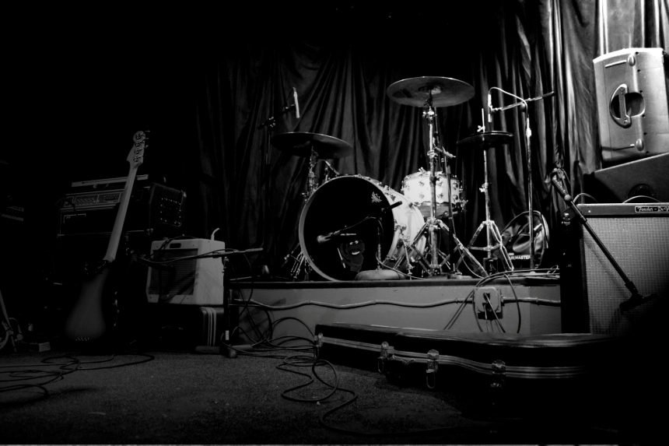
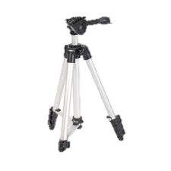
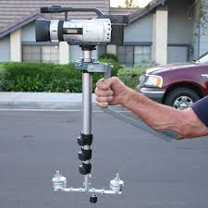
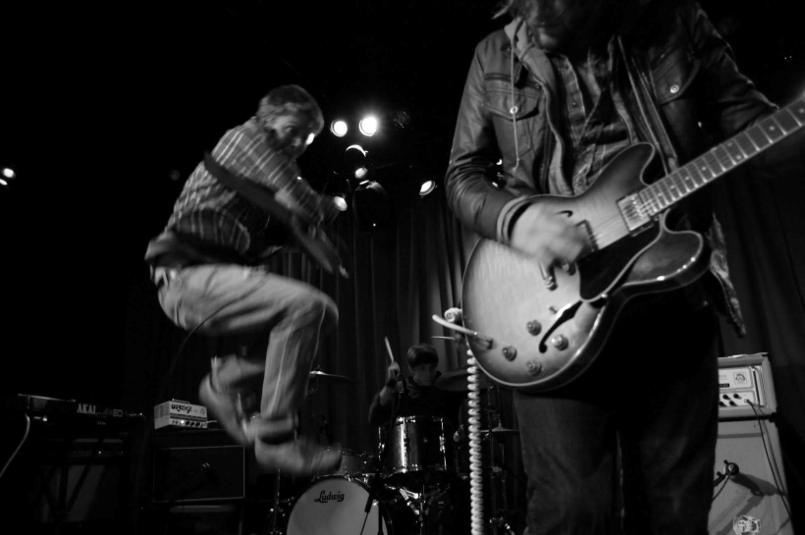
To ensure we achieve the shits we are aiming for we will be creating a merricam, which is a homemade steadicam. We will do this to ensure there is no jolting or movement within our shots. We will also be using a tripod to ensure the shots are steady however for some shots of the instruments we will be filming free-hand.
We will be using long shots of the instruments and equipment to give the viewer perspective of the venue and to set the scene.
We will also be using close up shots to show the intensity of the video and to convenience our viewers that it is real.

Slide 5
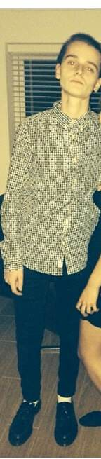
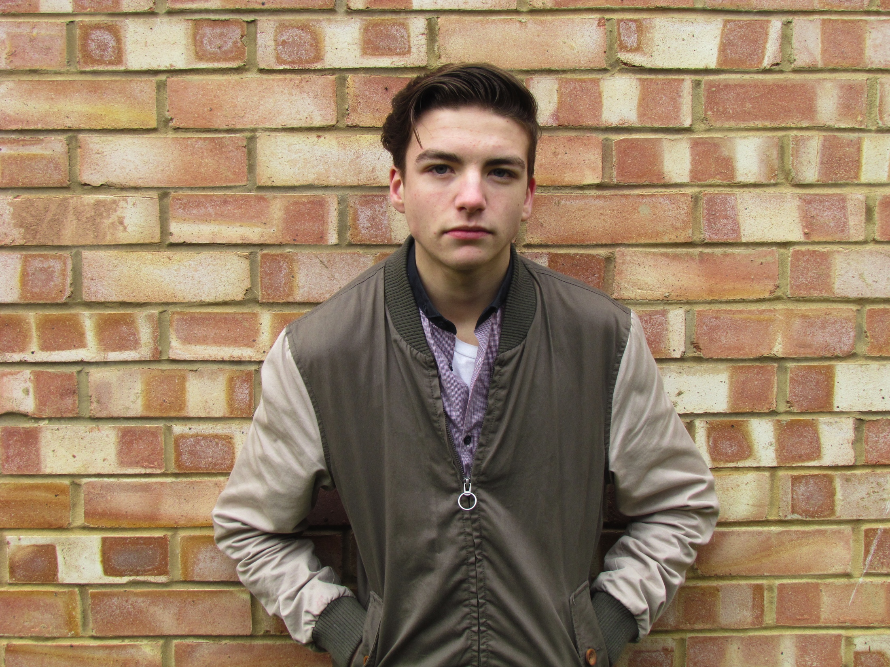
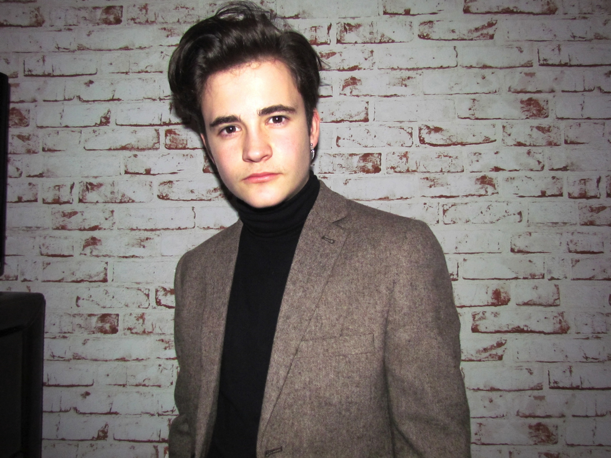
Plans for our video…
These are the 3 actors we have chosen to be in our video. We wanted to ensure that the people we chose we appropriate for our genre of indie rock. This will make the video look more believable and professional if they look as if they suit the song and image we are trying to portray.

Slide 6
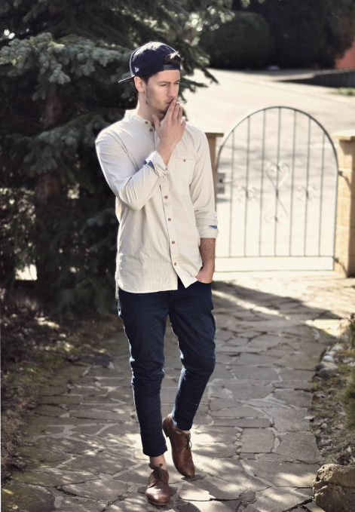
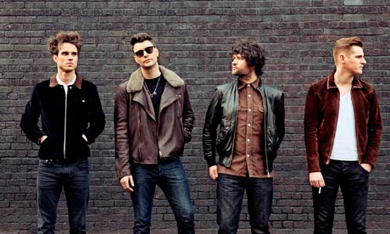
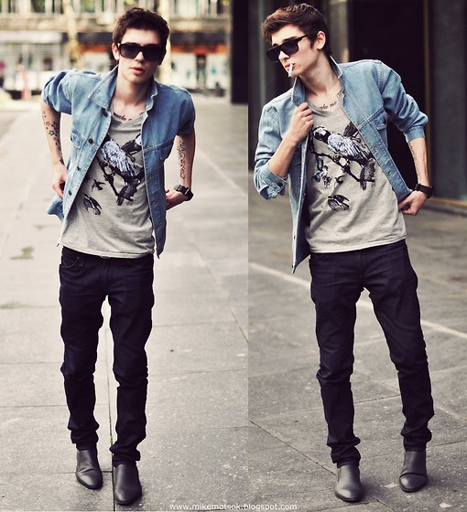
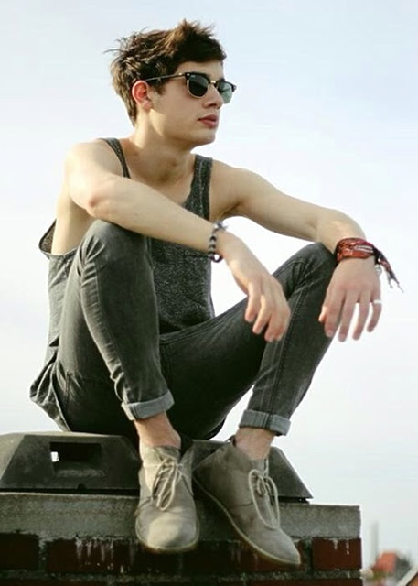
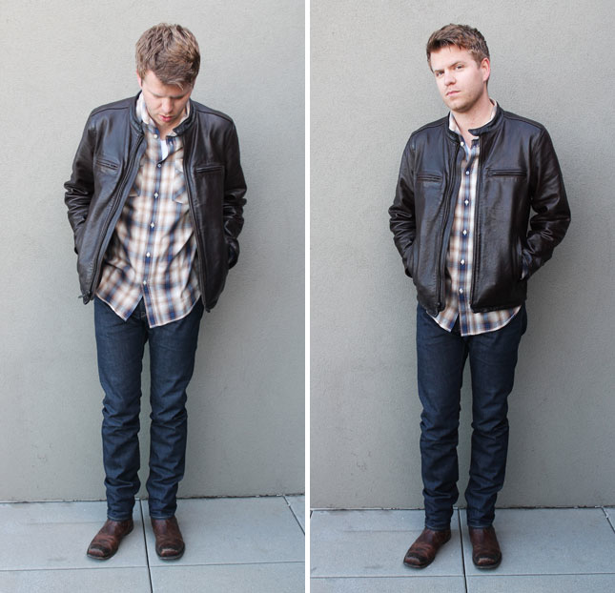
These are a few examples of the types of outfits we wanted our actors to wear. Trying to comply with our chosen genre, an average outfit is dark jeans, a ripped/baggy shirt and leather jacket, with messy hair and trainers or boots. We believe the outfit choice and to be thought through carefully as it is the main thing viewers focus on so will set the image for the video.

Slide 7
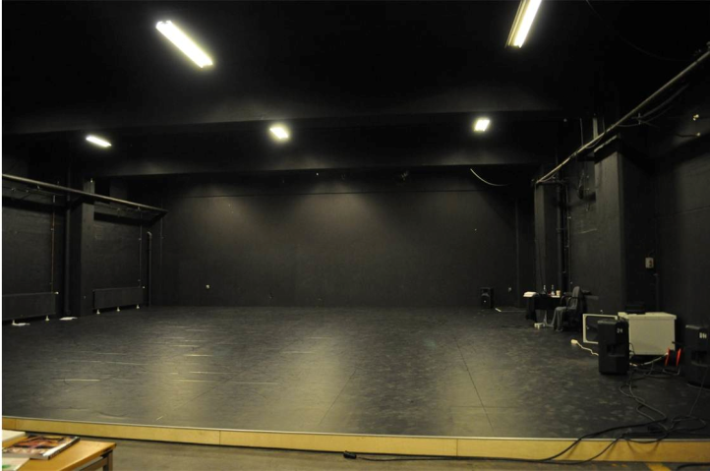
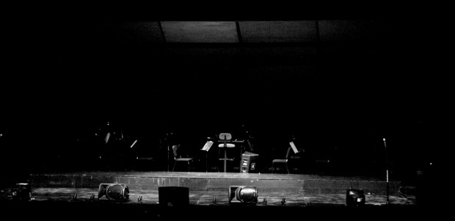
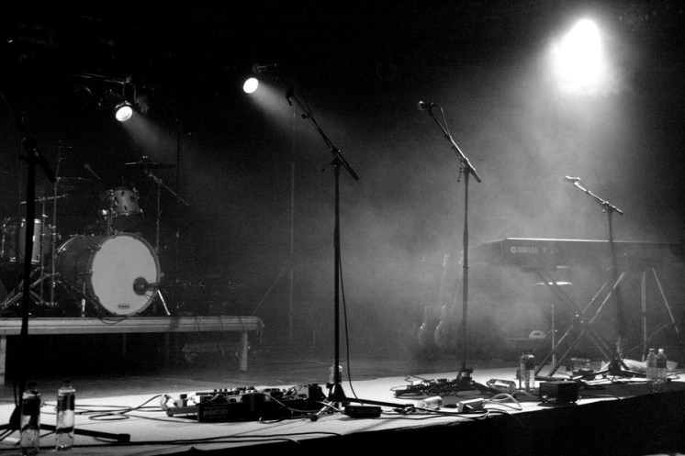
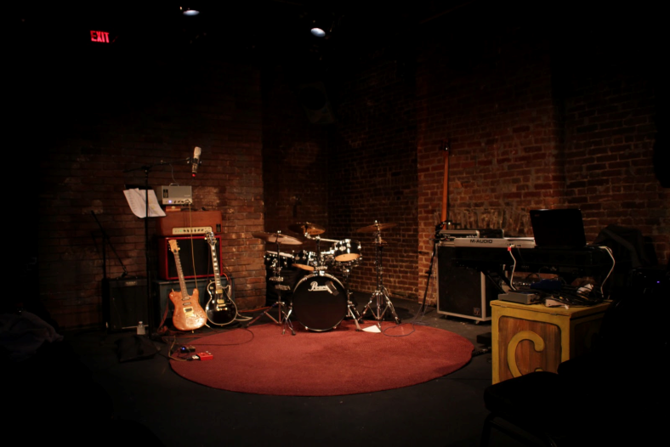
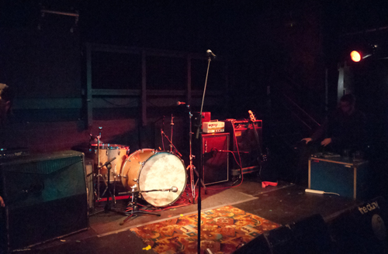
For our location choice, we have decided to go for a dark room, with recording equipment. Eg. Amps, microphones, drums and guitars. We will be using lighting to provide a professional affect on our video and ensure all the actors can be seen. We will either include a stage or not but have not decided on what’s best to use yet.

Slide 8
Thank You
https://www.youtube.com/watch?v=jkaMiaRLgvY

